Slide 1

VCU HUMAN RESOURCES PRESENTS:
HOW TO RETIRE WITH THE
OPTIONAL RETIREMENT PLAN

Slide 2
OBJECTIVES & AGENDA
What is ORP Retirement?
Distribution Options
Retiree Healthcare and Life Insurance Eligibility
Leave Payouts & Reemployment

Slide 3
ORP RETIREMENT BASICS
About the VCU Optional Retirement Plan (ORP)
Separation from state employment makes you eligible to draw income from the plan.
The ORP is a defined contribution plan (401a)
Funds available depend upon investment performance
Retirement distributions are arranged with your investment company provider, and must be approved by VCU

Slide 4
ORP RETIREMENT BASICS
When will I be eligible for distributions?
There is no minimum age or service requirement to begin distributions
No distributions while employed.
Must separate from all state service
Penalties may apply for non-periodic distributions prior to age 55

Slide 5
ORP DISTRIBUTIONS
Do I have to take a distribution when I retire?
No, unless minimum distributions are required
Required Minimum Distribution
If you have terminated your state employment, you must begin to receive your retirement distribution no later than April 1 following the calendar year in which you turn age 73

Slide 6
ORP DISTRIBUTIONS
Lifetime annuity
Joint and survivor annuity
Systematic fixed installment payments over a term you specify
Single lump sum payment
Must meet certain Section 401(a)(9) rules

Slide 7
MAKING DISTRIBUTION ELECTION
Consult your ORP Investment Company Provider
TIAA and Fidelity Individual Counseling Schedule
Investment Company Web Sites and Phone Contacts
Complete distribution request with appropriate ORP provider and the provider will reach out to VCU HR for approval

Slide 8
RETIREE HEALTHCARE
Eligible retirees will have the opportunity to enroll in State Retiree Health Benefits Program at the time of retirement.
An eligible retiree must enroll within 31 days of retirement unless they are covered under another state employee’s plan. Documentation of waiver for this reason is required to preserve future enrollment eligibility.

Slide 9
RETIREE HEALTHCARE
To qualify for retiree coverage, you must meet the age and service requirements that would have qualified you for an immediate VRS defined benefit under the VRS plan for which you would have been eligible had you not elected the ORP.
Anthem or Aetna bills participants directly for retiree health coverage.

Slide 10
CORRESPONDING VRS ELIGIBILITY
Eligible for VRS membership 6/30/2010 or earlier (VRS Plan 1)
Age 65 if you have at least five years (60 months) of service credit, or at age 50 if you have at least 30 years of service credit.
Age 55 if you have at least five years (60 months) of service credit, or age 50 if you have at least 10 years of service credit.
Eligible for VRS membership 7/1/2010 or later (VRS Plan 2 & Hybrid)
Normal Social Security retirement age with at least five years (60 months) of service credit or
when your age (years) and service (years) equal 90.

Slide 11
HEALTH BENEFITS
NON-MEDICARE ELIGIBLE PLANS
COVA Care, COVA HealthAware, COVA HDHP, Kaiser, Optima
Retiree pays full premium
For retirees and enrolled dependents not eligible for Medicare
Same plans and options available to active employees
Retirees and their covered spouses are eligible for the same premium discounts as employees
TRICARE Supplement Plan
For non-Medicare eligible retirees who are military retirees, or spouses/surviving spouses of military retirees, and eligible for TRICARE military health benefits
*

Slide 12
HEALTH BENEFITS
MEDICARE ELIGIBLE PLANS
Advantage 65
Retiree pays premium
For retirees and enrolled dependents eligible for Medicare
Supplements Medicare

Slide 13
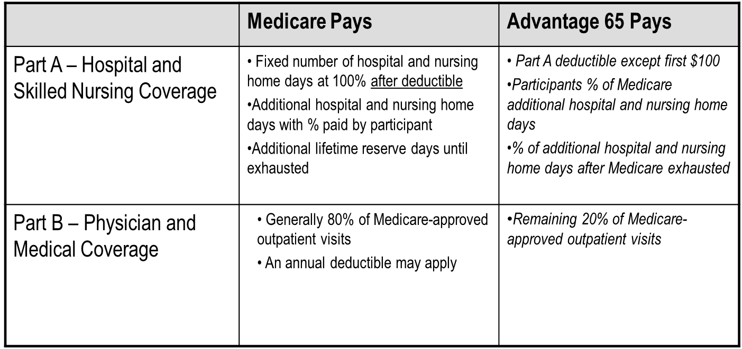
HEALTH BENEFITS

Slide 14
HEALTH BENEFITS –
PRESCRIPTION DRUG PLAN
 | Medicare | Advantage 65
Part D – Prescription Drug Coverage | Pays a benefit based on the specific Part D plan in which the beneficiary is enrolled. Generally limited by annual $ maximum unless catastrophic cost level reached. | Enhanced prescription drug plan, with no annual maximum. Annual deductible for brand-name drugs. No deductible for generics. See handout. You may elect Advantage 65 with prescription drug coverage only at retirement. You cannot later add prescription drug coverage to a Medical Only plan.

Slide 15
HEALTH BENEFITS – DENTAL/VISION OPTION
 | Medicare | Advantage 65
Dental and Vision Coverage | Generally provides no coverage for these services | Retiree Blue View vision program administered by Anthem. Retiree routine dental program administered by Anthem. Does not include coverage for prosthetic or complex restorative services. Expanded dental coverage is not available to Medicare-eligible retirees. Dental/Vision Option can be elected at retirement or added once later. Once canceled, re-enrollment is not available.

Slide 16
HEALTH INSURANCE CREDIT
Available to ORP participants who have 15 or more years of state service and meet the eligibility requirements for retiree health coverage.
Credit is $4 for every year of creditable state service.
NEW: Health Insurance Credit can be direct deposited. If you do not set up direct deposit with VRS a check will be mailed to your home address.

Slide 17
EXAMPLE 1
MONTHLY HEALTHCARE COST - SINGLE COVERAGE
Item | Cost
Medicare B premium (standard) | $164.90 ($97,000 or less income in 2021)
Advantage 65 + Dental/Vision | $330.00
VRS Health Insurance Credit (20 years of service) | ($80.00)
 | $414.90

Slide 18
EXAMPLE 2
MONTHLY HEALTHCARE COST - DUAL COVERAGE
Item | Cost
Medicare B Premium | $329.70 ($250,000 joint income in 2021)
Advantage 65 + Dental/Vision (single) | $330.00
COVA Care + Expanded Dental (single) for non-Medicare spouse | $837.00
Medicare D Income Related Adjustment | $31.50 ($250,000 joint income in 2021)
VRS Health Insurance Credit (25 years) | ($100.00)
 | $1,428.20

Slide 19
IMPORTANT NOTICE ABOUT PRESCRIPTION DRUG COVERAGE FOR MEDICARE-ELIGIBLE RETIREES
If you enroll in prescription coverage more than 3 months after your 65th birthday, Anthem’s pharmacy benefit management company will send you a letter warning that you are a late enrollee and subject to penalty.
If you have been continuously enrolled in the State Health Benefits Program from your 65th birthday until your retirement, you may disregard this letter.
*

Slide 20
IMPORTANT NOTICE ABOUT PRESCRIPTION DRUG COVERAGE FOR MEDICARE-ELIGIBLE RETIREES
The warning letter will include the following statement:
“If you had continuous coverage through the Commonwealth of Virginia Health Benefits Program since your Medicare eligibility, the Commonwealth of Virginia Department of Human Resource Management will attest to your coverage, and you may disregard this notice.”

Slide 21
IMPORTANT NOTICE ABOUT PRESCRIPTION DRUG COVERAGE FOR MEDICARE-ELIGIBLE RETIREES
If you were enrolled in any plan other than the State Health Benefits Program between your 65th birthday and your retirement, you will need to provide proof that you had creditable prescription drug coverage (i.e. coverage at least as good as Medicare Part D) during that period.
Contact VCU Benefits for a “Proof of Creditable Prescription Drug Coverage” letter if required.

Slide 22
RETIREE LIFE INSURANCE
Basic Group Life Insurance - after retirement
If you are eligible for reduced or unreduced retirement when you leave your VRS-covered position, you are eligible to retain your life insurance benefit.
Natural death benefit and accelerated death benefit continue at no cost to you.
Death benefit equal to your creditable compensation at retirement, rounded to the next highest thousand and then doubled.
Your coverage begins to reduce on January 1 following one calendar year after your employment ends. The reduction rate is 25% each January 1 until it reaches 25% of the total life insurance benefit value at retirement.
*

Slide 23
LEAVE PAYMENTS
Unused accrued leave is payable up to the maximum allowed by policy (Faculty or University and Academic Professional)
  You may defer your leave payment to the Virginia Deferred Compensation Plan (DCP) or VCU Tax-deferred Annuity (TDA) if you are a participant when you retire. If you do not defer leave payment, VCU Payroll Services aggregates final pay with leave payment and taxes total payment accordingly. You may adjust your tax withholding elections prior to retirement.
No payout for faculty sick leave

Slide 24
REEMPLOYMENT OF RETIREES
Must have a break in Commonwealth of Virginia employment of at least one full calendar month (between time of retirement from VCU and new employment in a non-covered position with any other state agency) during a period in which you would have normally worked in the position from which you retired;
For 9/10-month positions, break in service begins when you would have returned for next appointment period;
Must have a break in VCU employment of at least 26 weeks between the time of retirement and new employment in a non-covered position with VCU
Must not have a pre-arranged agreement to return to any Commonwealth of Virginia employment, including but not limited to VCU; and
Must not be hired to perform the identical job duties of the position from which you retired.
Any re-employment with the Commonwealth (including VCU) must be for a limited term (can only be hired into an hourly or adjunct position unless you stop retirement benefit). VCU re-employment requires VP approval

Slide 25
REEMPLOYMENT OF RETIREES
It’s important that retirees not be re-employed in non-covered positions with state agencies for more than 1,664 hours annually.
1,664-hour cap is imposed by IRS regulations. (IRS regulations dictate that such an employee must not work more than 80% of his/her previous full-time job. 80% of 2,080 hours = 1,664.) VCU policy limits hourly (wage) and adjunct employment to 29 hours per week or less, on average, over each May – April period.

Slide 26
PROCESS OF RETIREMENT
Determine retirement date:
  Must be the first of the month.
Complete retirement forms and submit to VCU Benefits.
Submit paperwork 30 days before retirement date.
Contact Investment company to view your retirement funds and distribution options. Note: Investment company obtains ORP distribution approval from VCU Benefits.

Slide 27
RETIREMENT FORMS (REQUIRED)
Acknowledgement of Eligibility Requirements
Termination Certification Form (ORP for Higher Education) (VRS-65D)
State Retiree Health Benefits Program enrollment form (to elect or waive)

Slide 28
RETIREMENT FORMS (OPTIONAL)
Investment Company Distribution Forms (TIAA and/or Fidelity)
Designation of Beneficiary (VRS-2) – for retiree life insurance
ORP Health Insurance Credit Certification (VRS-75) (if you have 15+ years service)
Salary Reduction Agreement (SRA) and/or DCP Payroll Authorization (online) form to stop deferrals to TDA and DCP
LTD Conversion Request (Standard Insurance Company)

Slide 29
RETIRED FACULTY AFFILIATE STATUS (FACULTY ONLY)
Retired faculty affiliate status may be granted by your department. Certain continued campus access and privileges are provided to faculty members who maintain ongoing relationships with the university. See https://faculty.provost.vcu.edu/retired-faculty/.
Confirm your Affiliate status with your department, and then request a Retiree ID Card authorization from the VCU Card Office. VCU Human Resources does not authorize retired faculty ID cards.

Slide 30
ADDITIONAL RESOURCES
State Resources
Virginia Department of Human Resource Management (DHRM)
Virginia Insurance Counseling and Assistance Program (VICAP)
Virginia Center on Aging
Other Agencies
AARP
IRS
Continued Learning
LifeLong Learning Institute
Senior Citizens Higher Education Program

Slide 31

QUESTIONS?
CONTACT INFORMATION:
HR Support ticket https://go.vcu.edu/hrsupport
BENEFITS TEAM CONTACT
BENEFITS@VCU.EDU
804-827-1723
Schedule a Retirement Consultation: http://bit.ly/3Cepja0

